Slide 1

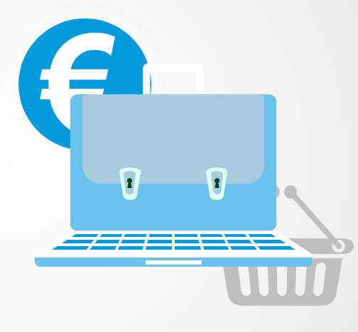
PAYMENT/MONETIZATION ANALYSIS
Presenter: Pegah Fattahi
Oct 2023

Slide 2
Time Period (Data-set)
2016-2018

Slide 3
AGENDA
OBJECTIVE
ANALYSIS OVERVIEW & INSIGHTS
I. PAYMENT DISTRIBUTION & BEHAVIOR ANALYSIS
II. CUSTOMER BEHAVIOR
III. PRODUCT & CATEGORY INSIGHTS
CONCLUSION

Slide 4
OBJECTIVE
PURPOSE
To discuss a comprehensive analysis of Olist's payment and monetization trends, providing invaluable insights for optimizing the payment strategies and maximizing revenue.
EXPECTATIONS
Through this presentation, we will explore various in-depth data-driven queries, categorized into various themes. Each query provides insights into different facets of our payment behavior, and together, they will weave a comprehensive narrative of Olist's payment ecosystem.

Slide 5
ANALYSIS OVERVIEW & INSIGHTS
I. Payment Distribution & Behavior Analysis
Popular Payment Methods: Started with an assessment of the most popular payment methods, giving us insights into the preferred transaction modes of our customer base.
Order Metrics per Payment Type: Delved into the number of orders and their corresponding payment values associated with each payment method. This helps us in understanding not just popularity but also the economic weight of each payment type.
Boleto Payment Dynamics: Specifically analyzed Boleto payment's peculiarities, looking at hours taken for approval and days taken for product delivery. Moreover, we evaluated the variance between actual and estimated delivery times, providing crucial data for operations optimization.
Installment Preferences: Investigated the prevailing number of installments chosen by customers, which gave insights into customer financing preferences and potential credit behaviors.
II. Customer-Centric Analysis
Growth Metrics: Observed the growth trajectory of our customer base, understanding both the number of customers and their growth rate over the years. This paints a picture of our market reach and potential saturation points.
Review Dynamics: Analyzed customer reviews, focusing on score distributions. We also investigated the correlation, if any, between the length of comments and the review scores. This helps in gauging customer satisfaction and identifying areas of improvement.
III. Product & Category Insights
Top 5 Categories: Identified the top five product categories. Beyond just looking at popularity metrics, we dug deeper to understand if these categories also aligned with the highest order frequencies.

Slide 6
PAYMENT & MONETARIZATION ANALYSIS
I. PAYMENT DISTRIBUTION & BEHAVIOR ANALYSIS

Slide 7
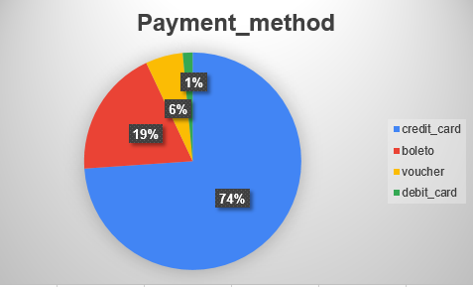
I. PAYMENT DISTRIBUTION & BEHAVIOR ANALYSIS
Insight:
The pie chart illustrates the distribution of various payment methods used by customers. The dominant method is 'credit_card', which accounts for a significant 74% of all payments. 'Boleto' follows with 19%, while 'voucher' and 'debit_card' represent a smaller portion at 6% and 1% respectively. The data suggests a strong preference for credit card transactions among customers, with other payment methods being utilized considerably less frequently

Slide 8
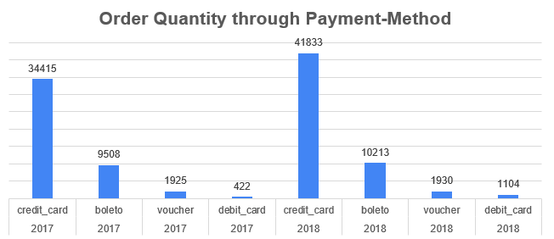
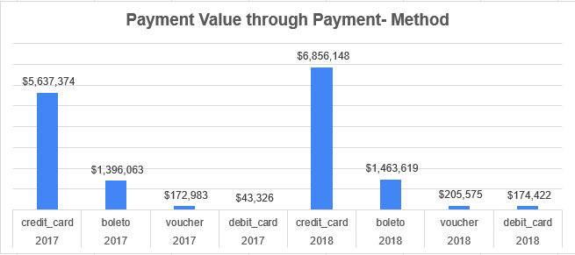
I. PAYMENT DISTRIBUTION & BEHAVIOR ANALYSIS
INSIGHT:
while credit cards dominate both in volume and value, it's essential to acknowledge the importance of diverse payment options and the distinct behaviors associated with each. Recognizing these patterns can inform promotional strategies, loyalty programs, and customer outreach initiatives.
Notes:
As we checked we understood the most popular method of payment used by customers is credit card and then comes the other payment method. Also we checked if the pattern remain the same in terms of revenue and number of orders.

Slide 9

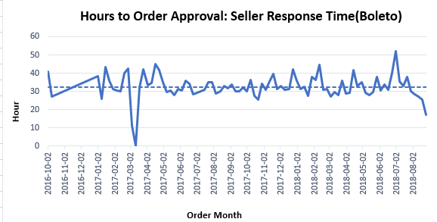
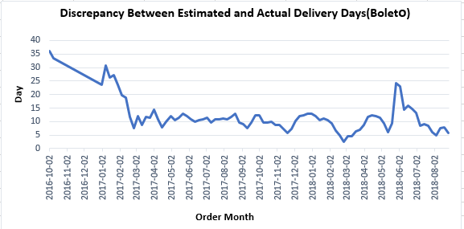
I. PAYMENT DISTRIBUTION & BEHAVIOR ANALYSIS
Notes:
Why boleto? When your customer uses Boleto as a form of payment, a Boleto or voucher is created specifically for their transaction, which is then sent via email. Anyone with a bank account can issue a Boleto with all the necessary payment information. It is a push payment, which relies on the consumer to initiate the payment, similar to using a bank wire.When your customer is ready to pay the Boleto, they can take it to any location that processes this payment method, or they can have it processed online. Once their Boleto payment is approved, the transaction is done. They will receive a payment confirmation immediately, while the actual payment will take additional time. Hours to Approve:
Initially, in early 2017, hours to approve were notably higher, almost reaching 29 hours in January. This showed a considerable improvement, dropping to values as low as 0.55 hours in March 2017. The hours to approve fluctuate over the years but reach a significant spike around April 2018, touching 22.88 hours.
The general trend indicates that the time taken to approve decreased over time but had a few intermittent spikes.
Days to Deliver:
The days to deliver started off at 11.5 days in January 2017, peaked around 18.6 days in late February 2018, and then notably decreased to as low as 2.23 days by the end of August 2018.
There is a decreasing trend in the delivery time from the start of 2018 till the end of the data in August 2018.
Estimated vs. Actual Delivery Time:
Throughout 2017 and 2018, there are periods when the estimated delivery time was higher than the actual delivery time, suggesting overestimations. This gap seems to increase especially around mid-2018.
For instance, in May 2018, the difference between estimated and actual delivery reaches a remarkable difference, with estimated times being more than double the actual delivery time.
General Trends:
There seems to be an efficiency improvement trend across 2017 and 2018, with approval times and delivery times both seeing general decreases.
There may be seasonality or specific events affecting these numbers. For instance, the notable spike in April 2018 might be due to some internal or external factors that affected the approval process.
Recommendation:
It would be beneficial to understand the root causes of the observed spikes and troughs to further refine the process.
Regularly revisiting and adjusting the estimation algorithm for delivery might lead to more accurate and trustworthy estimates for customers

Slide 10
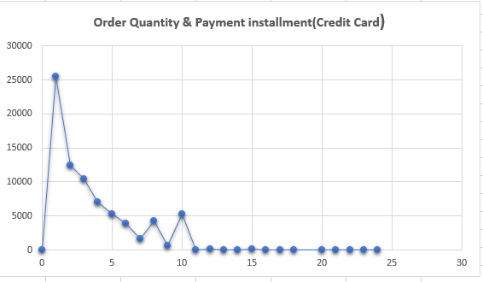
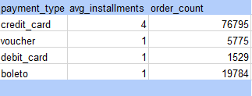
I. PAYMENT DISTRIBUTION & BEHAVIOR ANALYSIS
INSIGHT:
The majority of orders are made with one or very few installments. As the number of installments increases, the order quantity significantly decreases. Beyond 15 installments, the order quantity remains relatively stable and low.
Notes:
With the rise of e-commerce platforms, customer purchasing behavior has undergone significant changes. A pivotal factor influencing these decisions is the flexibility and availability of payment methods. In particular, the option to split payments across multiple installments can greatly influence a customer's decision to complete a purchase. This prompted us to examine the relationship between the number of payment installments and the total number of orders. Objective:
Determine if there's a correlation between the number of payment installments and the volume of orders. This insight will help us evaluate whether offering diverse installment options can influence customer purchasing behavior. It's important to note that only credit cards offer multiple installment options, as the installment count for other payment methods is typically set at one.

Slide 11
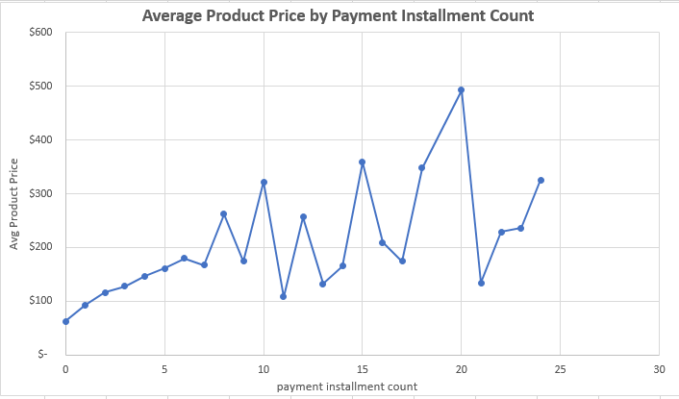
I. PAYMENT DISTRIBUTION & BEHAVIOR ANALYSIS

Slide 12
PAYMENT & MONETARIZATION ANALYSIS
II. CUSTOMER BEHAVIOR

Slide 13
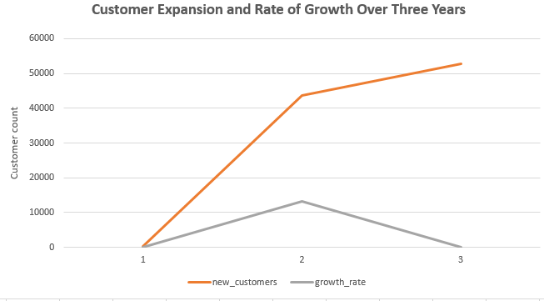
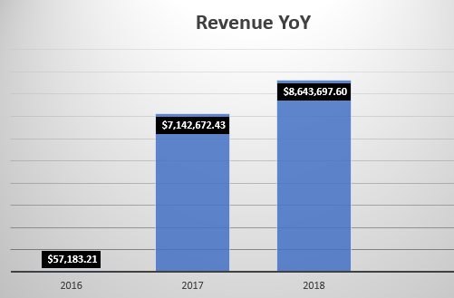
II. CUSTOMER BEHAVIOR
Year | Customer | Growth Rate
2016 | 326 | ----------
2017 | 43713 | 13311.04%
2018 | 52749 | 20.68%

Slide 14
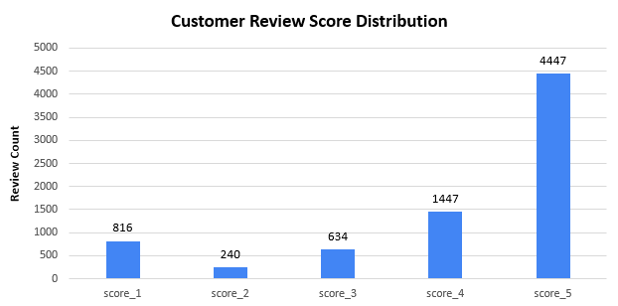

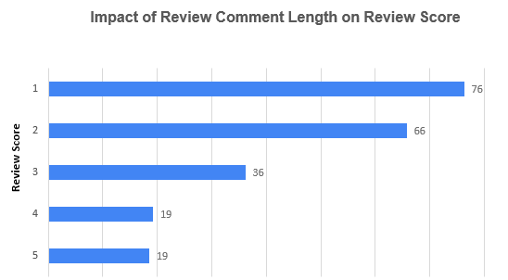
II. CUSTOMER BEHAVIOR

Slide 15
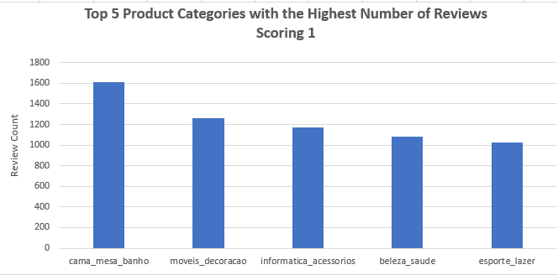
II. CUSTOMER BEHAVIOR

Slide 16
PAYMENT & MONETARIZATION ANALYSIS
III. PRODUCT & CATEGORY INSIGHTS

Slide 17
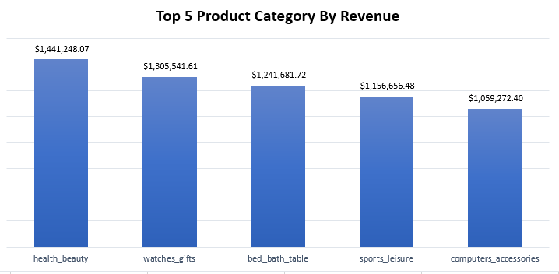
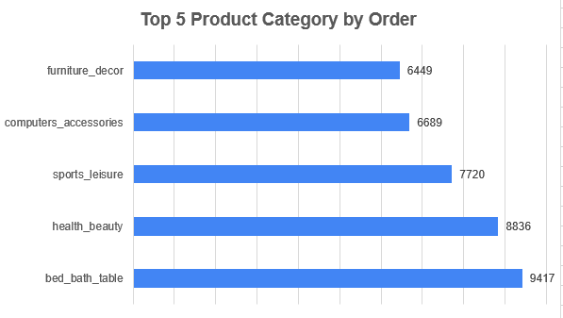
III. PRODUCT & CATEGORY INSIGHTS
Notes:
I want to gather information about top 5 product category
- I am curious to know if they are the most ordered or not

Slide 18
CONCLUSION:
Popular Payment Methods:
Majority prefer certain transaction modes, indicating clear market favorites.
Order Metrics Insights:
Payment method choice impacts economic weight.
Some methods are popular but account for lower overall transaction value.
Boleto Payment Dynamics:
Longer approval times observed.
Variances noted between expected and actual delivery times, signaling a need for operational improvements.
Installment Preferences:
Customers exhibit specific financing behaviors.
Insight into potential credit behaviors can guide business credit policies.
Product Ratings:
Majority of customers give a product score of 4 or 5.
Notably, a significant portion also rate the product as 1.
Order Preferences:
Most ordered products aren't necessarily the most valued.
Order Status Bar Chart Observations:
Overwhelming number of orders marked as 'delivered'.
Negligible counts for 'shipped', 'canceled', 'unavailable', 'invoiced', 'processing', 'created', and 'approved'.
Indicates a potential highly efficient delivery system.
Product Cancellations:
Certain products were canceled over 20 times.
Need to investigate underlying reasons for these cancellations

Slide 19
THANK YOU

